Slide 1

Career coaching center yangon – Singapore
MR Nay Zaw Aung
MISS Khaing Su

Slide 2

Welcome all of you
Welcome to our Career Coaching Yangon-Singapore Center’ I am very excited that you are in my class this batch. We are going to have a new resume, cover letter, premium email, applying a job and finally we get a perfect job.
I can’t wait to get to know who will be the first one to get a job in Singapore in this Batch.

Slide 3


Goals for Success
IF you want to succeed, you need to set a goals. Without goals you lack focus and direction; it also provides you a benchmark for determining whether you are actually succeeding.

Slide 4
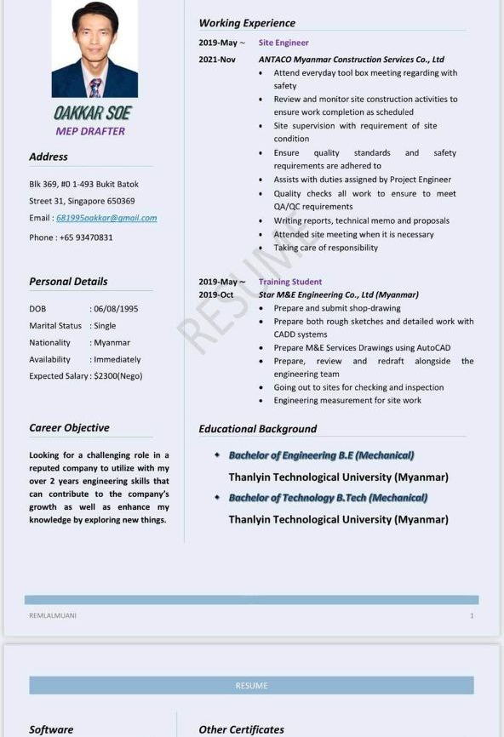
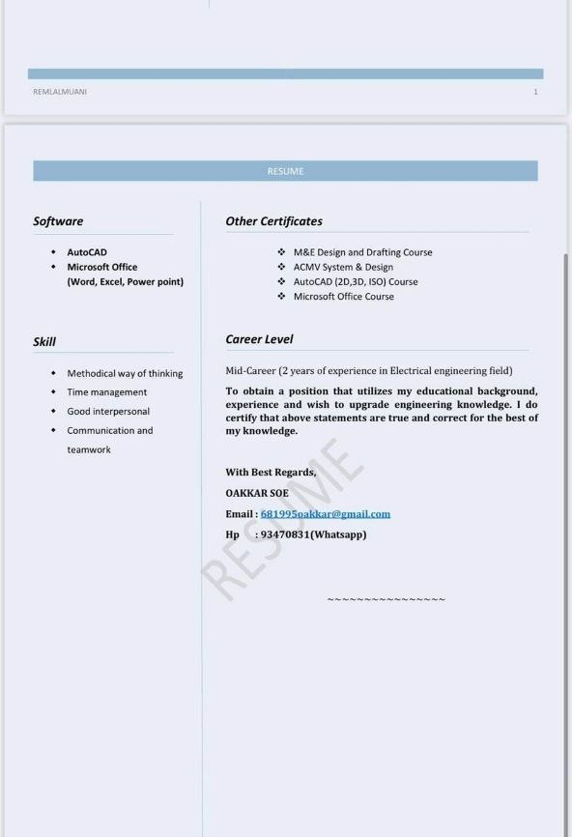
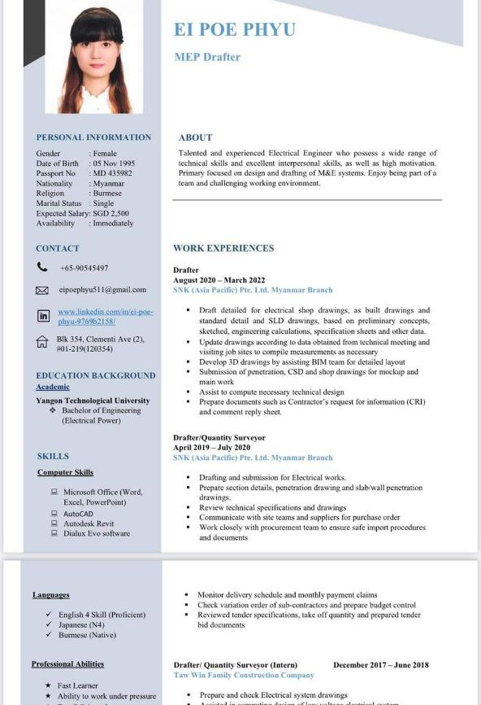
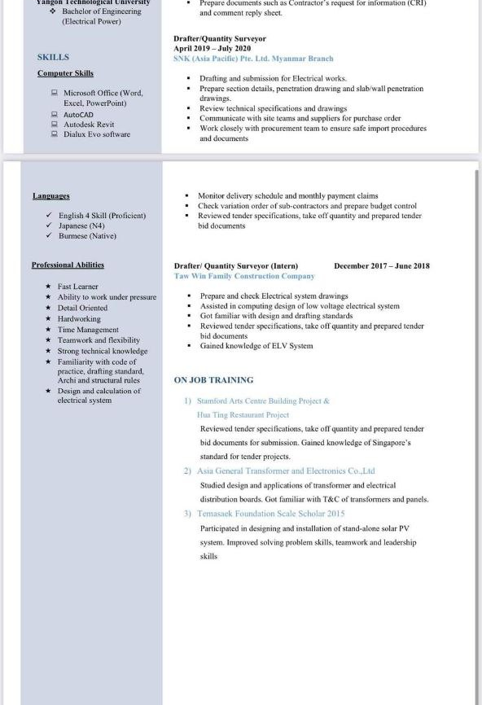
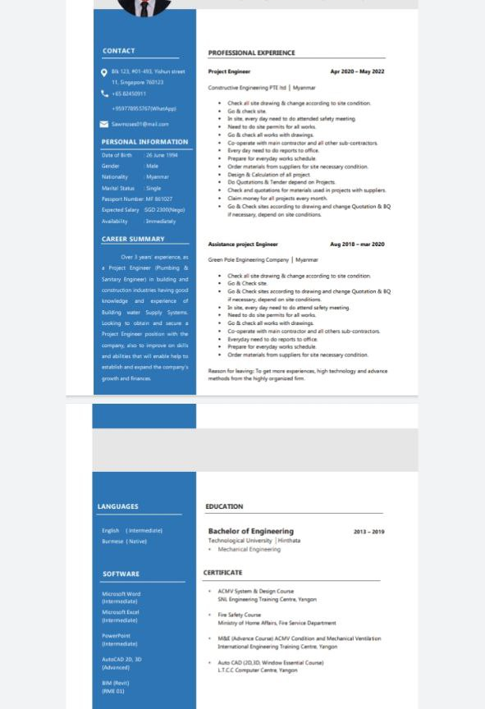
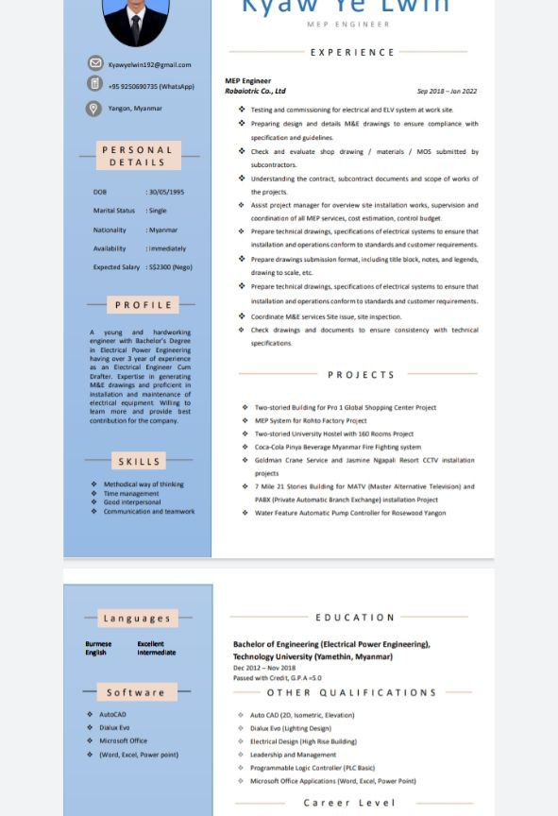
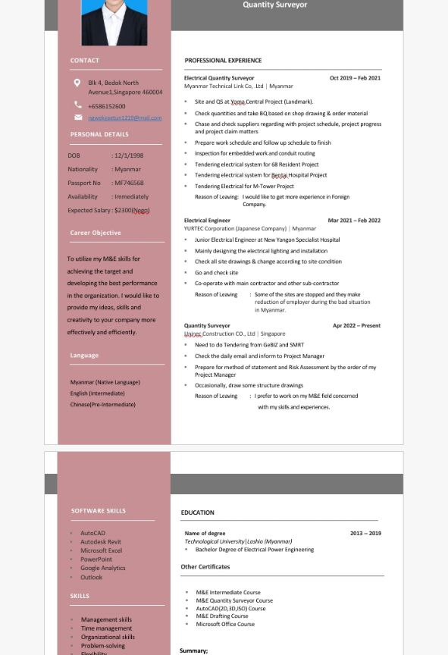
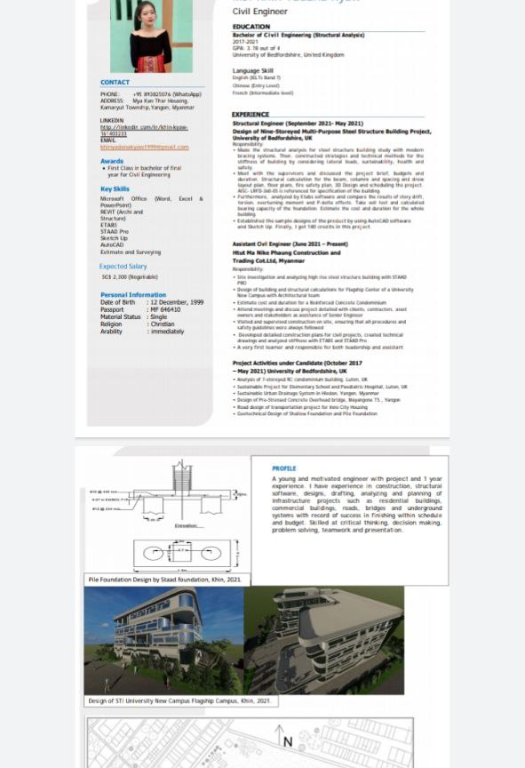
Resume Sample

Slide 5
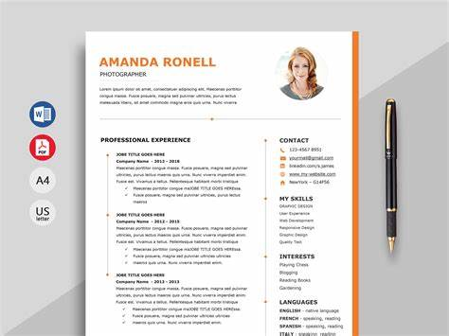
Resume Titles
Contact Info
Personal Info
Headline
Experience
Education
Skills
Extras
Check
Formatting
Grammar
Spelling

Slide 6
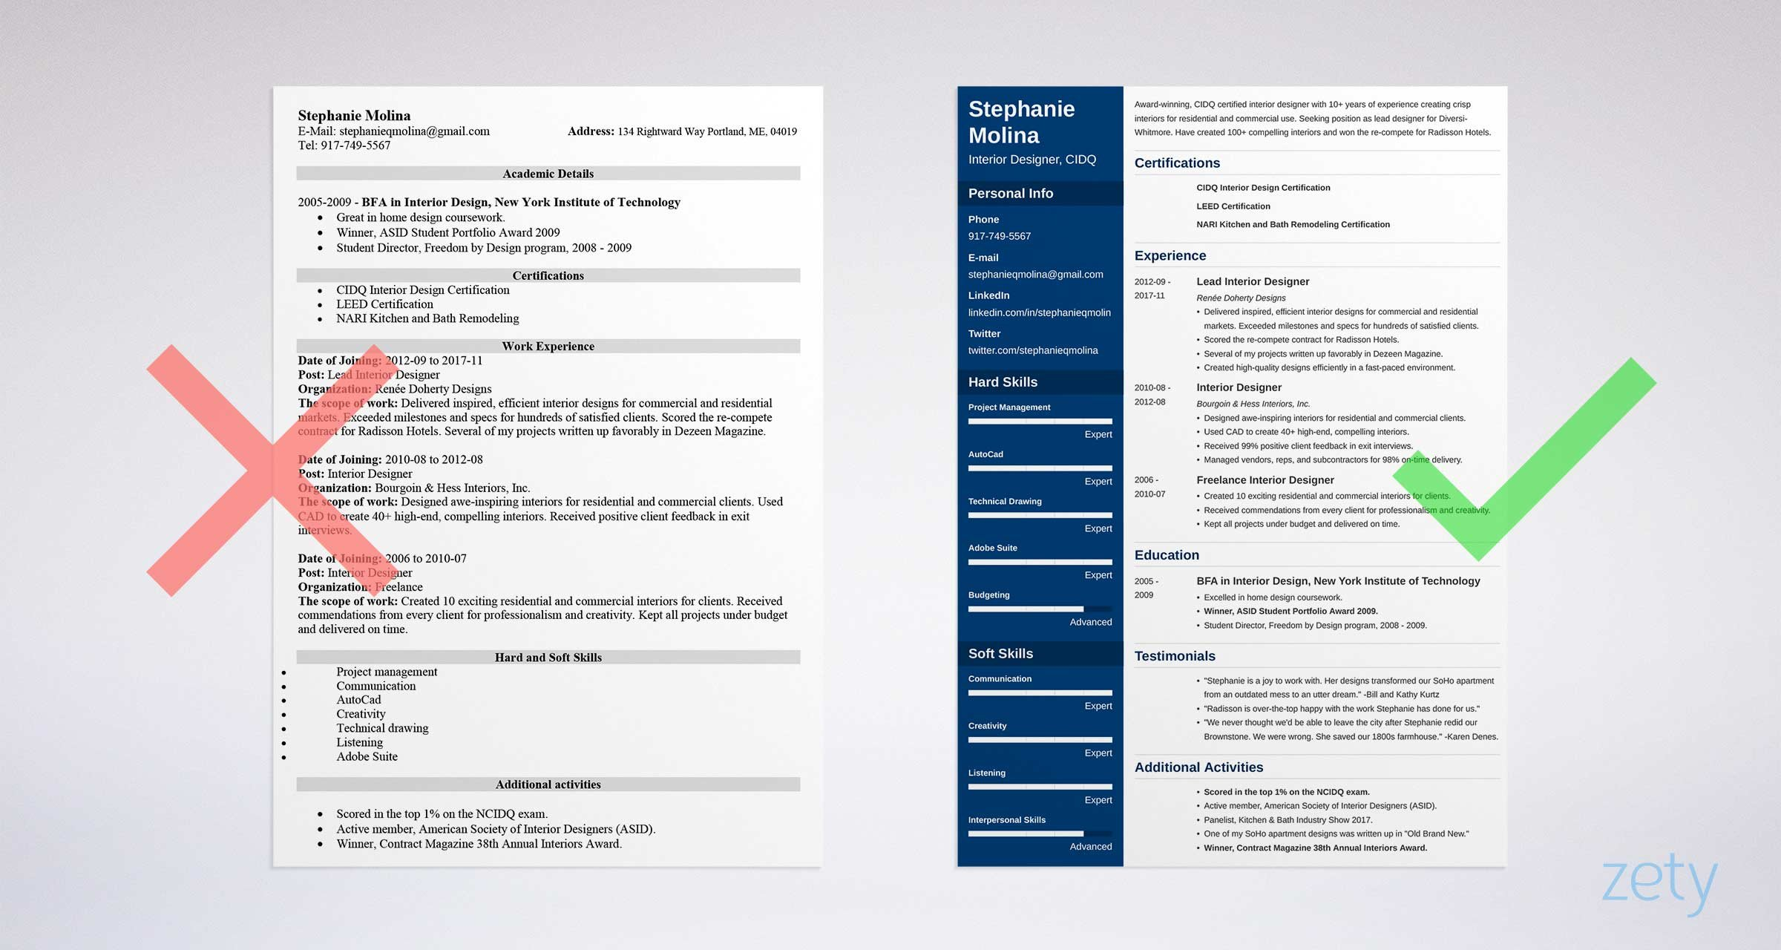
This Photo by Unknown Author is licensed under CC BY

Slide 7
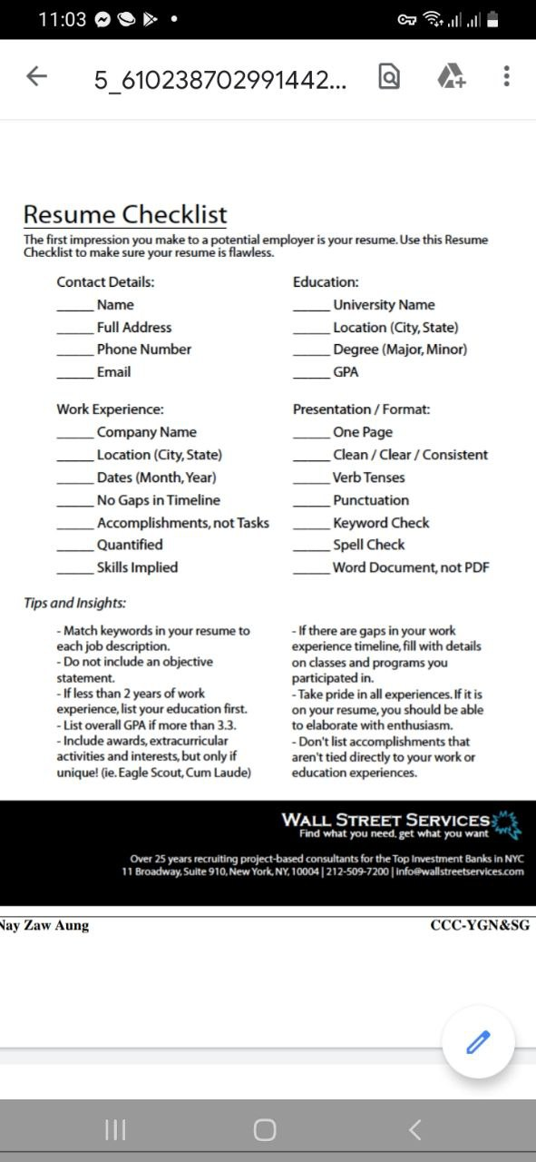
For detail
Example,
Address : street, city, country, postal code
Phone number: +959or +65
WhatsApp no : +959
Email : @gmail.com
LinkedIn :

Slide 8
The things you’ve done Professional Experience
List your experience in reversed chronological order In other words, put your current or most recent work experience first and your very first experience at the end of the list.
Must-have items for each employer Job Tile, Company name and place, period of employment and a list of responsibilities/ tasks. Consolidate experience older then 10-15 years, If you have had many employers, you should describe the most recent ones to the fullest and summarize the older work experience.
You can easily do this by removing tasks and responsibilities. Use present tense for current position and past tense for previous positions. And Simple tense is preferred over continuous tense.

Slide 9
List of action verb
Created | INCREASED | PARTICIPATED | RESEARCHED | LEAD
Administered Designed Formed Instituted Built Developed Formulated Introduced Charted Devised Implemented Launched Constructed Engineered Incorporated Defined Established Initiated | Accelerated Enhanced Gained Lifted Advanced Expanded Generated Maximized Amplified Furthered Improved | Collaborated Contributed Listened Shared Combined Coordinated Represented | Analyzed Discovered Interpreted Tested Assessed Evaluated Measured Tracked Audited Examined Quantified Calculated Identified Surveyed | Administered Executed Mentored Presided Chaired Headed Moderated Spearheaded Controlled Hosted Orchestrated Directed Mediated Oversaw

Slide 10
Personal Profile Experience
With over 8 years of experience as Office Manager, I have developed a broad range of professional skills. I’m a disciplined and organized person, and have the ability to provide management support in day-to-day activities.
In my work, I have a hands-on mentality and I’m proficient in administration. I can work efficiently in fast changing environments and know how to multitask.
I’m looking to broaden my horizons again and therefore I seek a full-time position within the field of Office Management, where I can develop myself on a professional and personal level.
Here’s what to keep in mind: • Be straight to the point This is a sales pitch, not a cover letter. Stay below 150 words.
List your key-skills The skills listed in your summary should be relevant for the job that you are applying for.
Speak in 1st person You can only use the 3rd person when you have a ghostwriter. It’s a personal document created by you, so it’s logical to use the 1st person.
Use full sentences Your CV has to be grammatically correct. Shortening sentences is not accepted.

Slide 11
CAREER SUMMARY
Result-driven professional accountant passionate about excellent problem-solving skills and ability to perform well in a team. Seeking to help your company develop their business as a accountant, as well as grow and develop my own skills and career achievement.
Looking for senior drafter position in a reputed company. Have over 10 year working experience in construction field. I believe my ability and skillset would be a great help for your business.
I hereby declare that all above information is true and correct.
Sincerely,
Mr. Thawzin
+9592345678
A resume summary is a professional statement at the top of a resume. It describes the candidate's relevant experience, skills, and achievements. The purpose of this career summary is to explain your qualifications for the job in 3-5 sentences and convince the manager to read the whole resume document. And you're about to learn how to nail it.

Slide 12
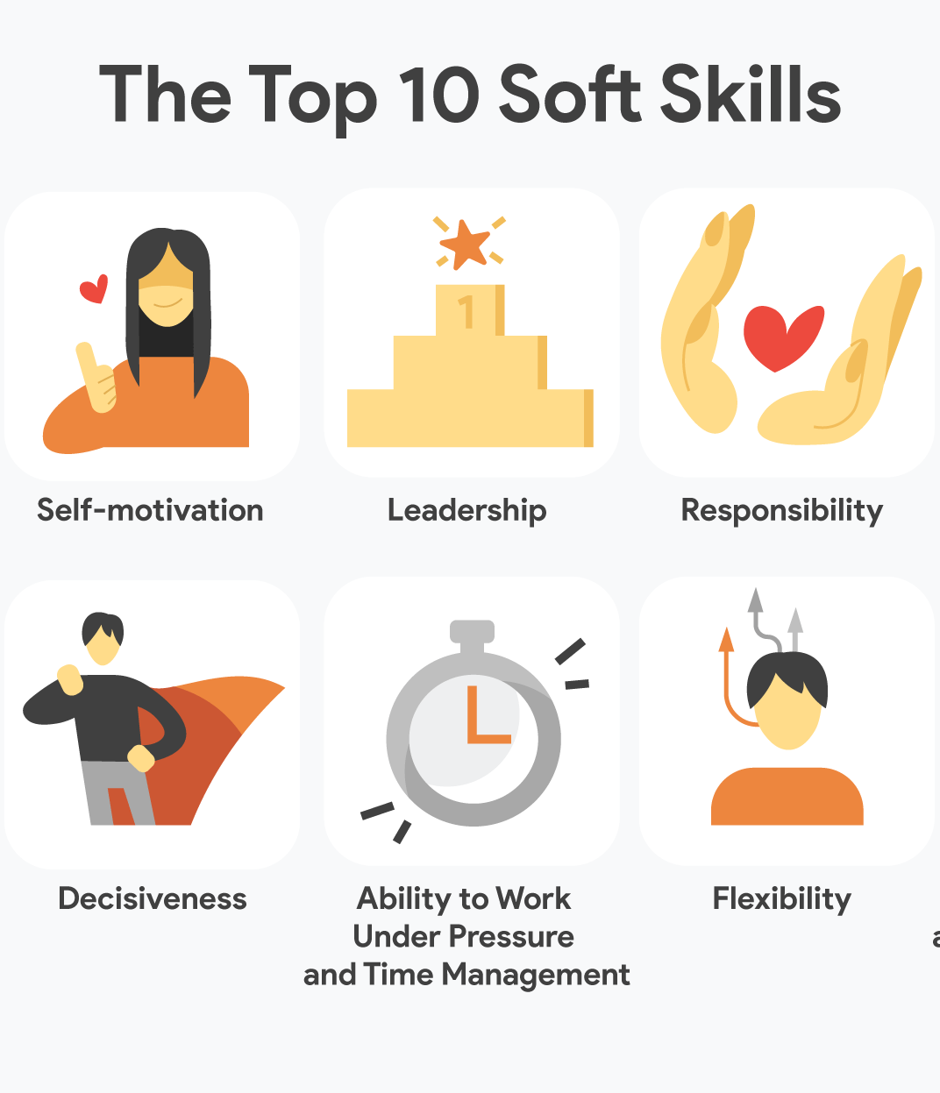
Soft skills
Leadership
Teamwork
Flexibility
Integrity
Problem-Solving
Creativity
Self-motivation
Communication
Adaptability
Work Ethic
Decisiveness

Slide 13


The things you’re good at
Computer Skills
AutoCAD,
Revit,
IT software,
Microsoft office, power point, excel
Language Skills
A1 Beginner
A2 Elementary
B1 Intermediate
B2 Upper Intermediate
C1 Advanced
C2 Proficient

Slide 14
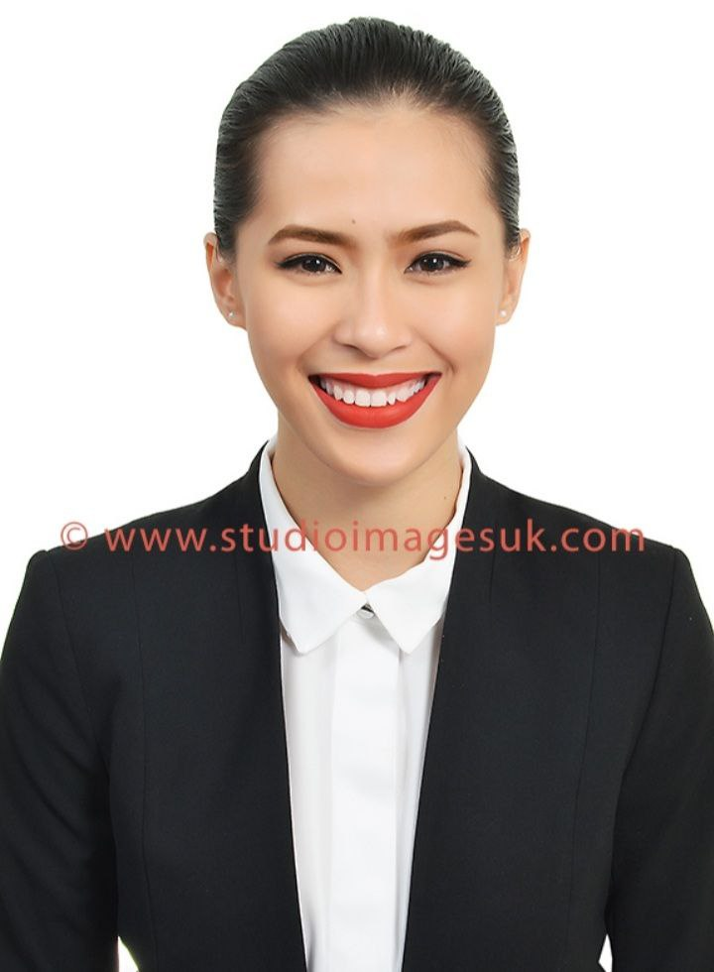
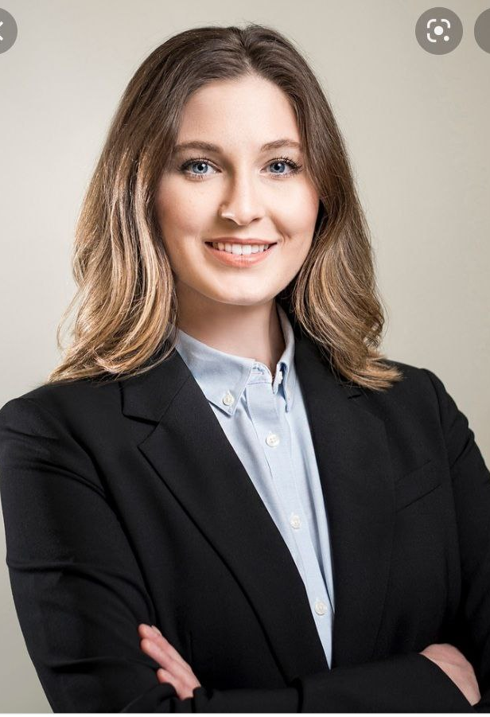
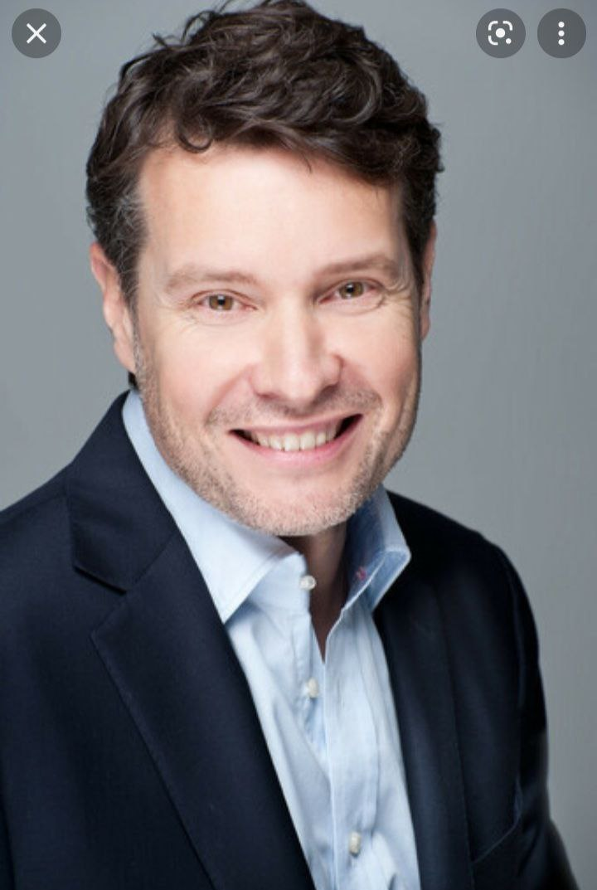
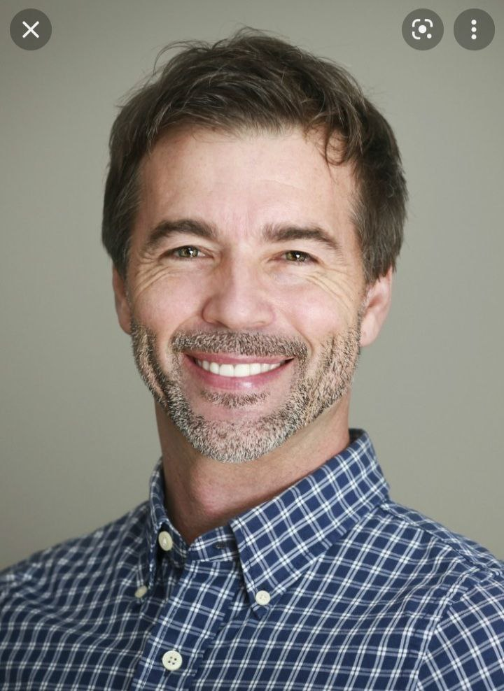
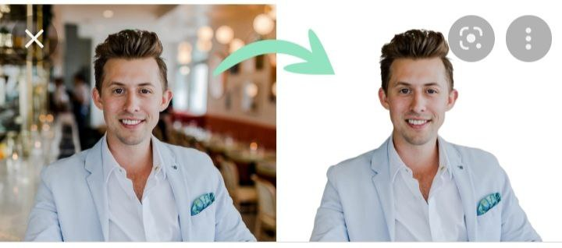
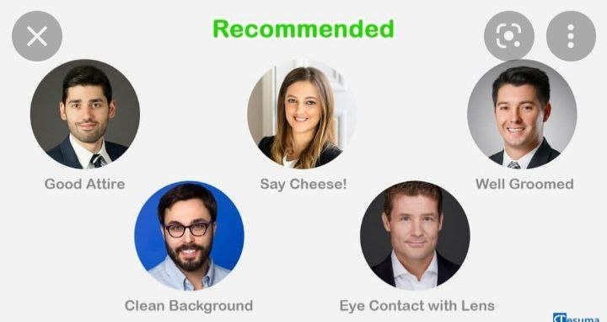
PHOTOgraphy

Slide 15
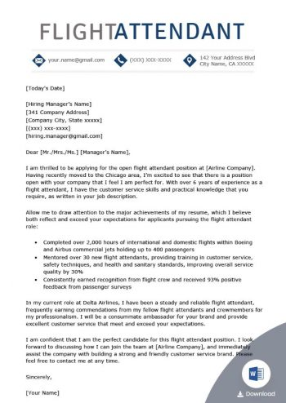
Cover letter
Same Font
Same Size
NO Bold
No Italic
Not too long
This Photo by Unknown Author is licensed under CC BY

Slide 16

Key takeaways:
A cover letter lets you explain why you're a good fit for the role and company.
Format cover letters like a standard business letter.
Customize each cover letter for the specific job you're seeking.
This Photo by Unknown Author is licensed under CC BY

Slide 17
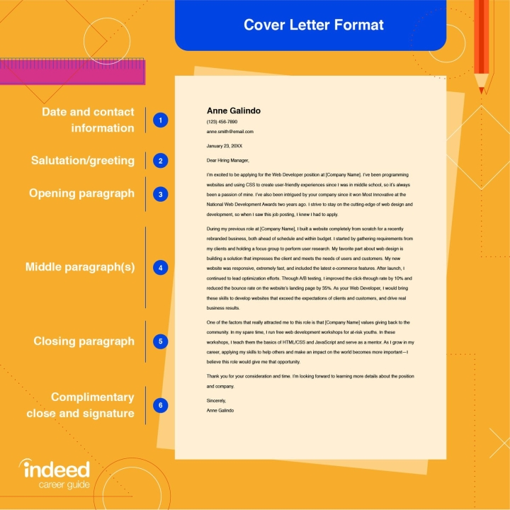

Slide 18
How To Write a Cover Letter (With Steps, Examples and Tips) | Indeed.com
A cover letter should include the following parts:
Header
Salutation
Introduction
Body paragraph
Closing paragraph
Letter ending and signature

Slide 19

Lets try together
This Photo by Unknown Author is licensed under CC BY-SA-NC

